Slide 1
AI and privacy leakage

Slide 2



(Semi) Automating this bottleneck!
Research results for publication
Graph or table of summary results
Data Repository
Researcher Analytical Environment
Disclosure Control Checking Process
Subset of pseudonymised data
Export from TRE
AI trained model
AI trained model
By starting the process at the point of creation
TRE
Software using AI model
Safe
People
Safe
Projects
Safe
Setting
Safe
Data
Safe
Outputs
Notes:
So now on to how this relates to GRAIMatter….
This is a high-level schematic of the well-established TRE controls for supporting standard statistical analysis. A subset of pseudonymized data is provided for researchers within the analytical area, they carry out their analysis and then the aggregate level results are checked by the disclosure control team before allowing export. Such exports are graphs or summary tables which are straightforward for a TRE team member to review and check that it doesn’t contain potentially disclosive data.
Now for AI, the same pseudonymized data is provided, it is used to train an AI model which then needs to be exported. This typically includes large arrays of numbers, which are extremely difficult for TRE team members to manually check.

Slide 3
Setting the scene: issue with ‘traditional’ outputs
Internal SDC guidance 2022 02 v01.mp4

Slide 4
Statistical Disclosure Control (SDC) Issues/ solutions
Tables
Identify and infer things about individuals:
‘k-anonymity’
Minimum threshold for number of people in each cell in table
Infer things about everyone in a group of people:
‘class disclosure’
Try to avoid zeros
Unless you can argue they. Are ‘structural’
Regression Models
Infer things about individuals if you know most of their data
Minimum number of ‘residual degrees of freedom’
Num. data records
– num. trainable parameters
>10

Slide 5
‘Traditional’ Outputs: The SACRO library and viewer
Outcomes of UKRI/ DARE UK ‘Driver’ project:
Responding to need identified by TREs in DARE’s ‘landscape review’
6 universities, 4 public data bodies, 5 TREs,
2 x PIE groups, international steering group
Design ethos: Engage and involve the researchers
‘Within Activity’ risk assessment: shared responsibility for Safe Outputs
No changes for workflows for data manipulation
‘Like-for-like’ drop in replacements for data queries: Shared Experience across different TREs
Tools that work for TREs AND THE PUBLIC
Open Source Community, peer support for new adopters, range of training materials
As little bespoke code as possible
ACRO libraries available via CRAN and PyPi:

Slide 6





SACRO in a nutshell
ACRO engine
ACRO
engine
Confidential
data in
TRE
Stata,R,Python
Results &
Risk Analysis
‘Statsbarns’
Conceptual
Framework
request
TRE risk appetite
File1
File1
SACRO viewer
decision
File1
Filen
TRE staff
ACRO report
Notes:
In SACRO the process looks the same except:
The TRE can specify their risk appetite in human and machine-readable form.
The researcher they prefix commands with ‘acro’ . In return for that they get instant feedback about outputs that are likely to get refused, and some tools to help manage their dialogue with the output checkers.
Internally our ‘acro engine’ captures their analytic calls and adds some automated disclosure risk checks before making a risk report that sumarises most of the things people would otherwise do by hand.
And the whole process can leave an audit trail.

Slide 7

‘Sort of a solved problem’ ..... But what about AI?”
Impossible to avoid some degree of automation when checking for disclosure risks
Ultimately needs to be a human decision:
https://blog.downloadyouthministry.com/just-say-no/

Slide 8
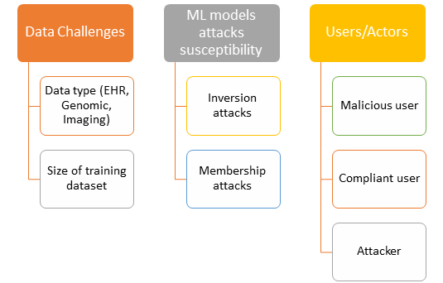
Background: The Risks
Malicious user: hide row level identifiable data within exported data arrays
Non-malicious user: unknowingly train AI model which incorporates training data directly
Trained models always remember aspects of training data; exports can be susceptible to malicious attacks
Disclosure control of machine learning models from trusted research environments (TRE): New challenges and opportunities, Heliyon, Volume 9, Issue 4, 2023, e15143, ISSN 2405-8440, https://doi.org/10.1016/j.heliyon.2023.e15143
Notes:
We have just submitted a paper identifying the various disclosure risks. E.g., a malicious user could hide row level, potentially identifiable data, within the data arrays to be exported
A non-malicious user could unintentionally train an AI model which incorporates training data directly into the model; a major risk with K-nearest neighbours and Support Vector Machines
In general, trained models remember aspects of the training data so when exported can be susceptible to malicious attacks; two examples being membership inference or model inversion attacks

Slide 9
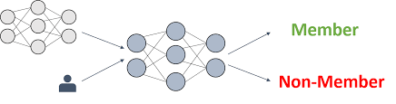
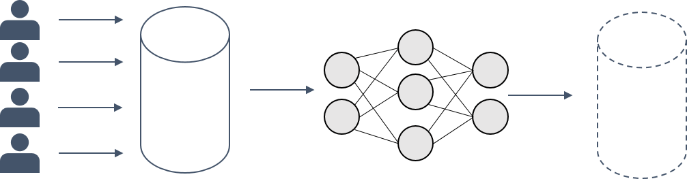
Background: Attacks
Membership Inference attack:
WAS?
Attribute Inference Attack :
WHAT?
Model Inversion attack:
WHO?
Age | smoker |  | Diabetes | ...
56 | y | ... | N | ...
34 | N | ... | ? | ...
https://franziska-boenisch.de/posts/2020/12/model-inversion/

Slide 10
Common features: Basic premise
Model M will have:
higher (or at least different) confidence in its predictions
for items it has been trained on
than for ones it has never seen
Because Conf(M,x,y_true) is e what is optimised during training
Model M
Input record X
Classes Y=y1,y2,y3,...yn
True label y_true
Softmax prediction:
Predicted label y_pred is highest from y1,...yn
Confidence C(M,x,y_pred)

Slide 11
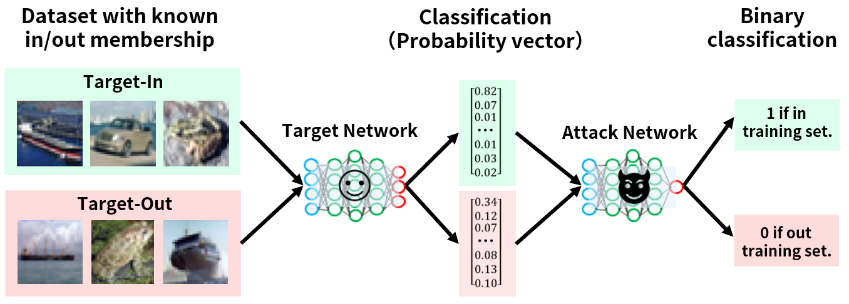
https://www.mbsd.jp/aisec_portal/attack_mi.html

Slide 12
Membership Inference attacks: shadow models
Depends how much data the attacker has access to.
Create dataset of ‘similar’ data records
Train a ‘shadow model’ for a similar task
Use
shadow model confidences,
along with knowledge of whether record was used to train shadow
To learn a third model ‘in dataset or not’
Idea is that this then generalises when we use confidences from our target model

Slide 13
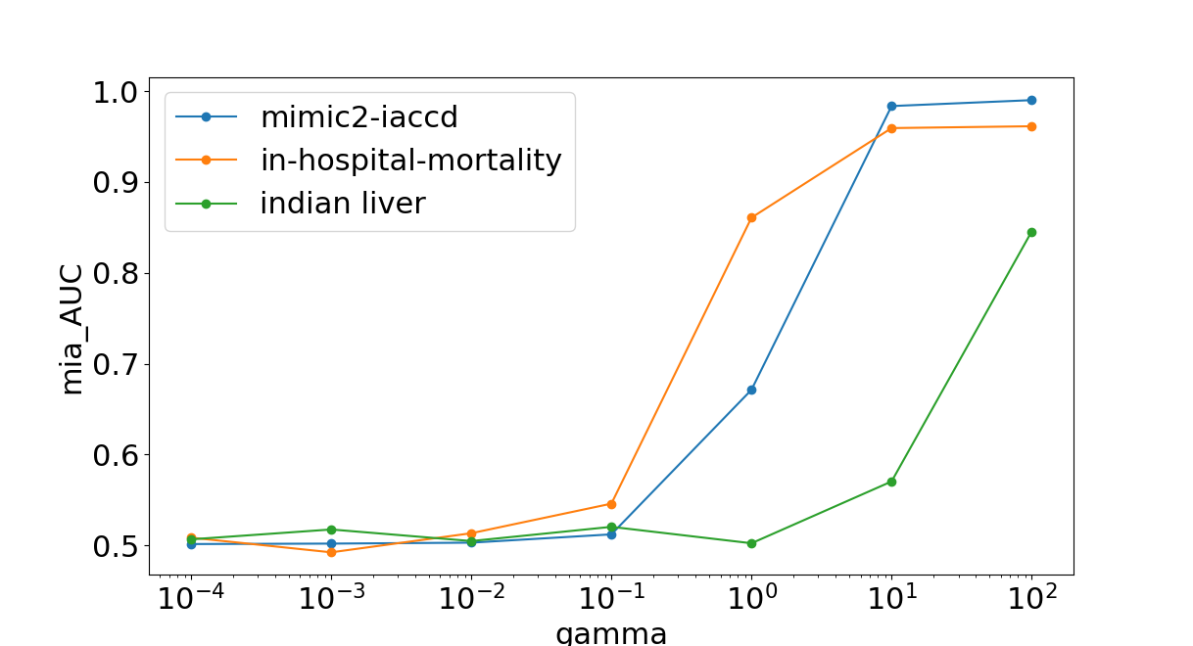
Member Inference Attack Results
Vulnerability cannot be prospectively determined – experiments on a trained model are required.
>1M models created and attacked
Preliminary results suggest that there are model + hyper-param combinations that are always dangerous.
>90% vulnerable models can be predicted
Holding some data from researchers would make attack simulation for TRE staff more reliable.
RISK
Different hyper-parameter values (SVM)
Notes:
WP1:
Here is an example result of one such experiment– this time using a Support Vector Machine.
The X-axis shows increasing values of a hyper-parameter – as it increases the SVM can create more complex decision boundaries. The lines show the results for different data sets. The Y-axis shows an indicator of success at a membership inference attack where the higher the value the more successful the attack.
The results from this particular experiment make it clear that values of this hyperparameter should not be allowed to be increased beyond a certain value (10 to the -1 where the AUC value increases above 0.55) -- I.e. they can form the basis of implementable guidelines and parameters to use for safe wrappers (as I will discuss in the next slide).
WP1 has shown that the level of attack simulation is automatable and could be run by TRE staff.
Preliminary results suggest that there are model + hyperparam combinations that are dangerous and should be avoided
Holding some data from researchers would make attack simulation for TRE staff more reliable.

Slide 14
Attribute Inference Attacks If I know everything else about someone can I find out their ...
Loop through all possible values f for missing features
Find model confidence in prediction for completed record
Categorical variables: predict value f
prediction correct
Unique value f and only one value with max confidence
Continuous attributes
Set of valuers f given correct prediction all within +/- 10% of each other

Slide 15
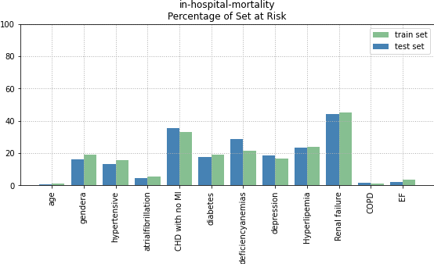
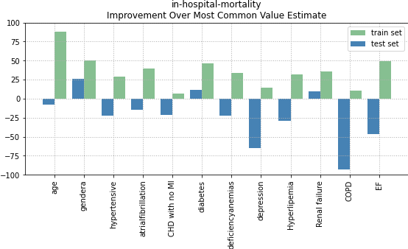
Results: Attribute Inference Attacks Target is 'naïve' random forest trained on hospital mortality Contrast results for records used to train target model (green) or not (blue)
Not all records are vulnerable to inference
Sometimes attack says 'don’t know'
Inference accuracy
Up to 100% on training set data
Worse than baseline for test data

Slide 16
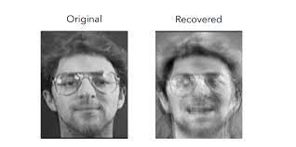
Model inversion attacks
Start with random input
Get model probability for a given class
Perform local search on input parameters to fins new input that maximises the probability of the given class
Figure 1: An image recovered using a new model inversion attack (left) and a training set image of the victim (right). The attacker is given only the person’s name and access to a facial recognition system that returns a probability
From
Published in Conference on Computer and Communications Security 2015
Model Inversion Attacks that Exploit Confidence Information and Basic Countermeasures
Matt Fredrikson, S. Jha , T. Ristenpart

Slide 17
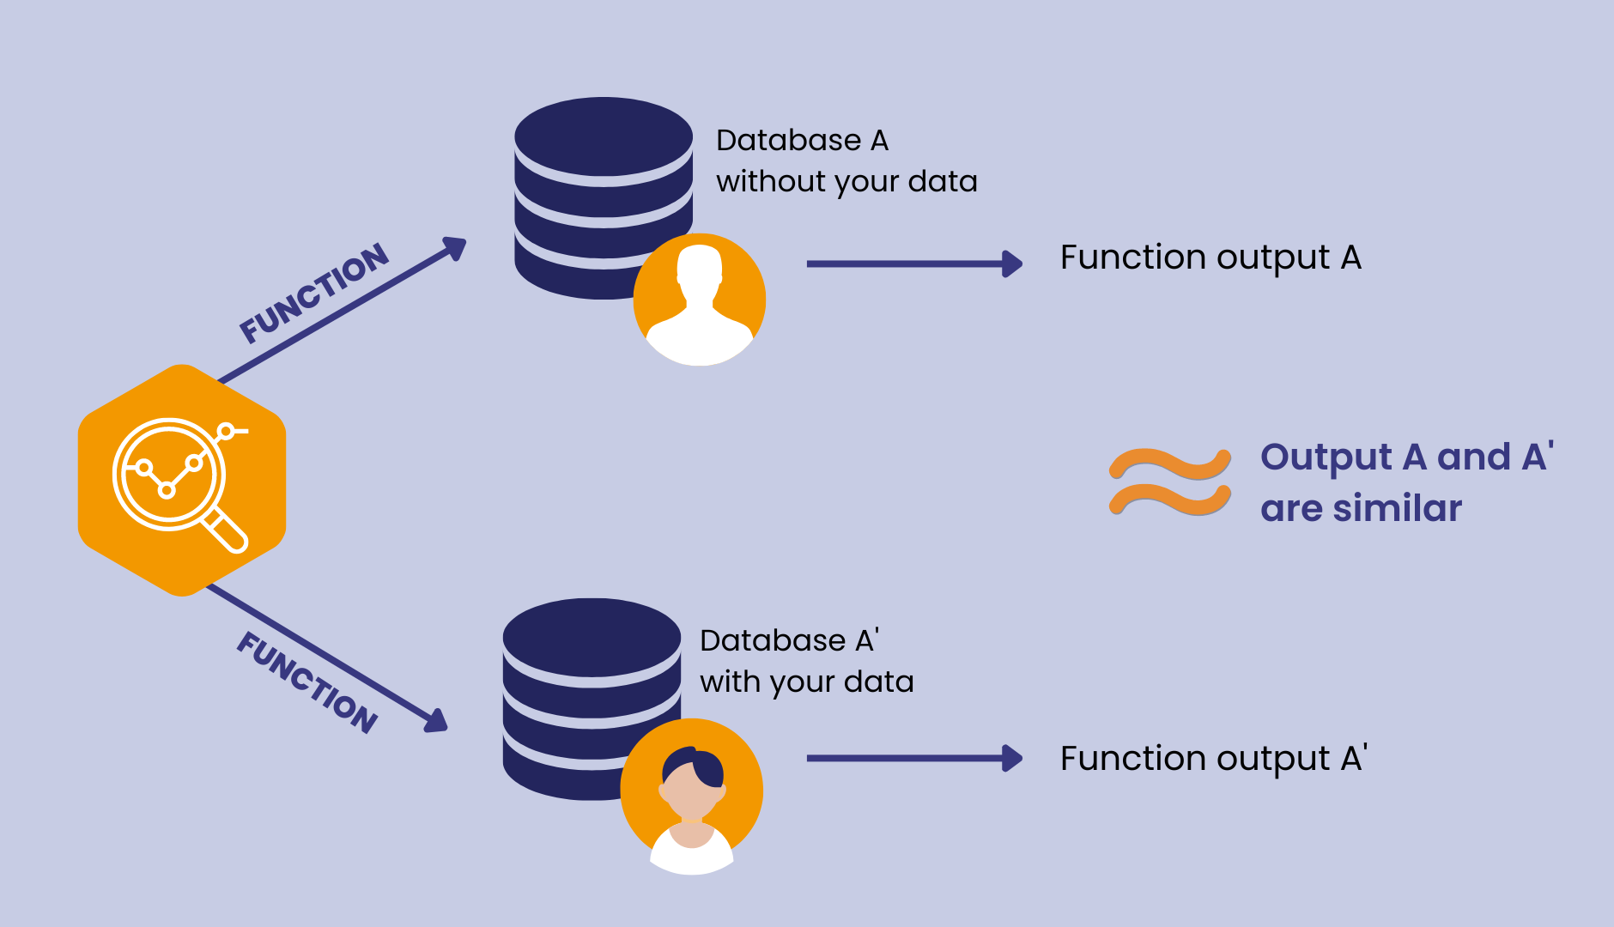

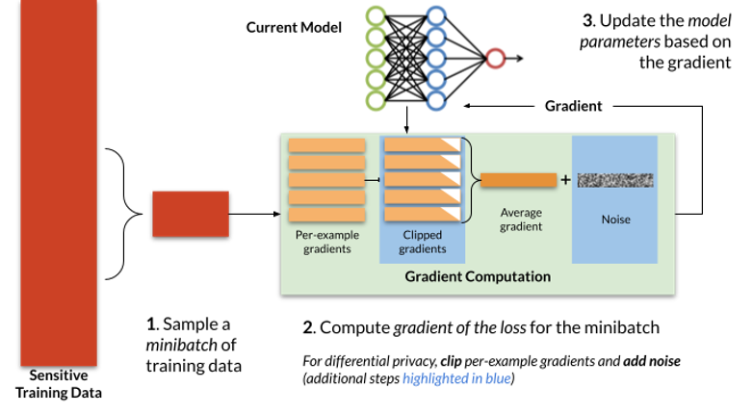
One solution: Differentially Private ML
Claim: your data doesn’t make much difference
Typically eta <1
-doesn’t account for class disclosure
https://www.nist.gov/blogs/cybersecurity-insights/how-deploy-machine-learning-differential-privacy

Slide 18
Issue: large gap between ML-Privacy and SDC theory
Different Questions:
SDC: If I know X is in the sample what else can I infer from this output?
Membership Inference: Can I predict if X was in the sample?
Attribute Inference: Are my guesses about X better if they were in the sample?
Different Metrics:
SDC: Risk to Most Vulnerable Person
ML Privacy research: Mean risk to all people
Differential Privacy: risk averaged over {people} x {guesses}
Different Approaches:
SDC: Concept of reasonable risk based on theory /statistical arguments
ML Privacy: empirical results: lots of methodological problems^{1,2,3,4}

Slide 19
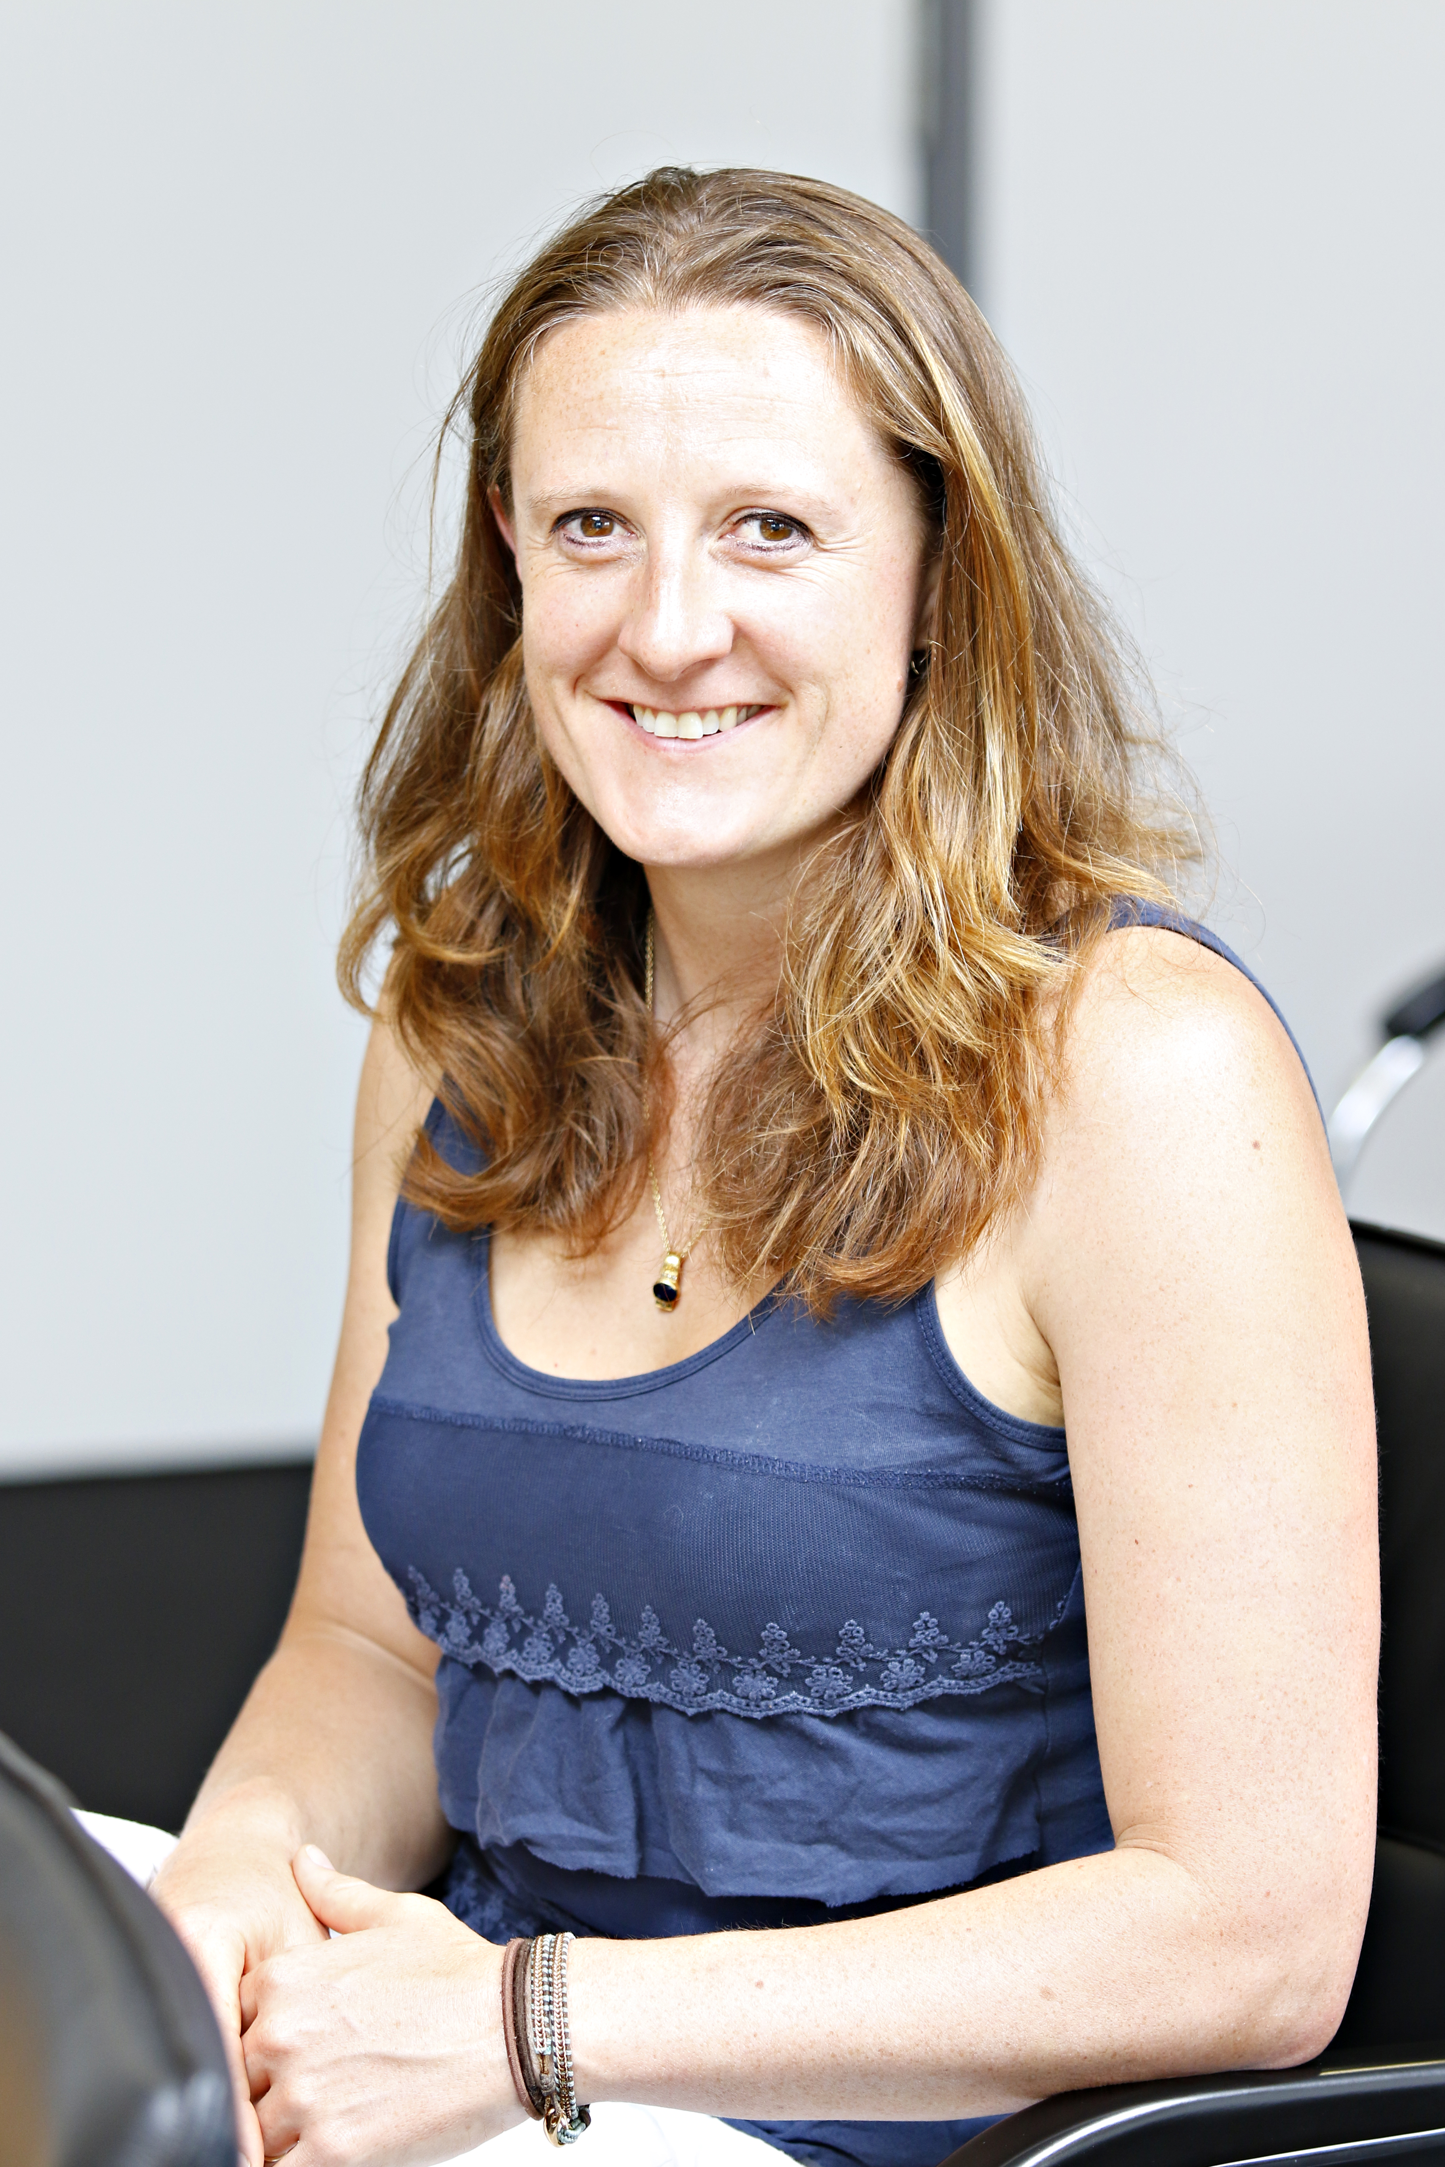




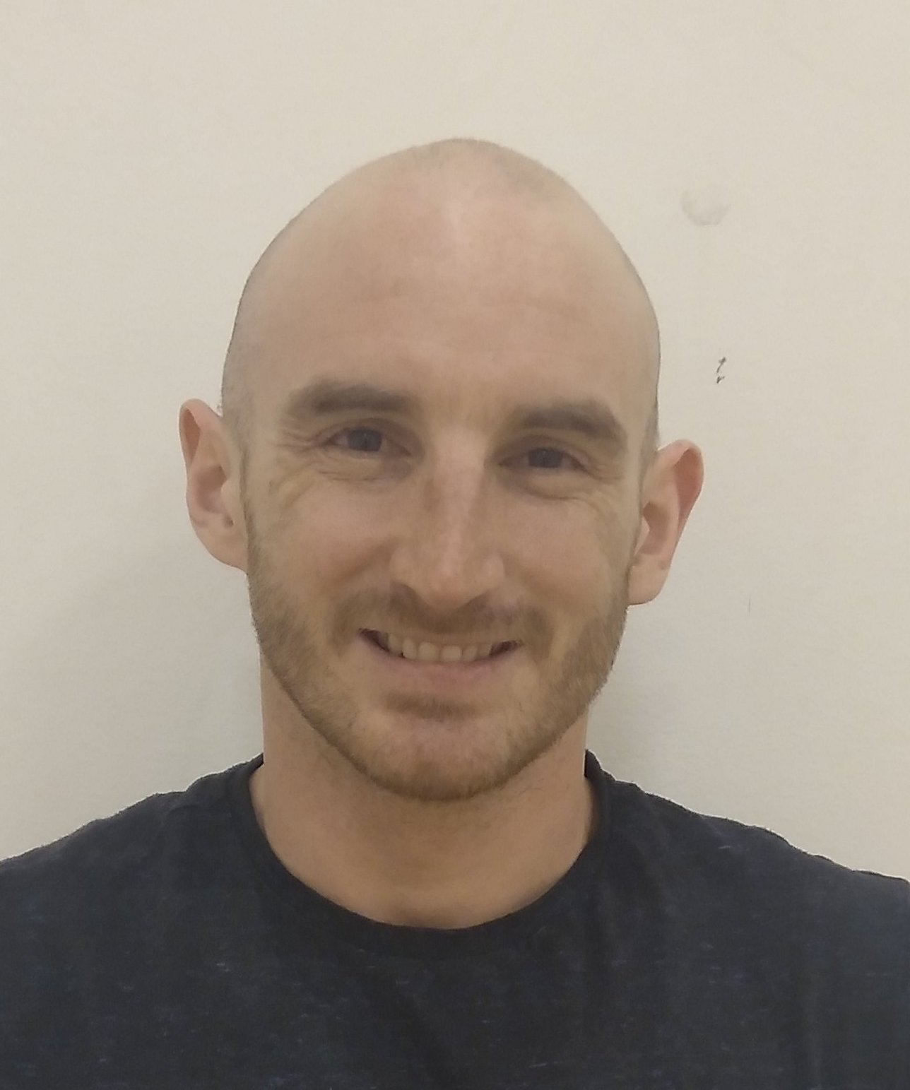
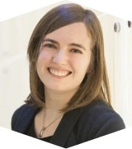
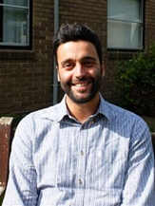
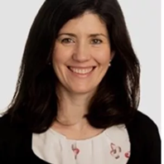

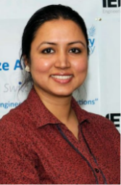




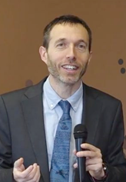

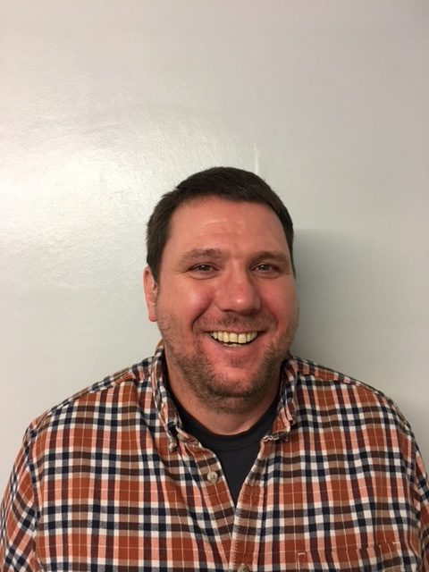








GRAIMatter project
Law and Ethics
Prof Emily Jefferson (PI):
Director of HIC TRE
Prof Felix Ritchie:
5 Safes and
Disclosure Control
Prof Jim Smith:
AI Models
Dr Christian Cole:
Senior Lecturer
Dr Simon Rogers:
Principal Engineer -
AI Models
Dr James Liley:
Assistant Professor
in biostatistics
Prof Angela Daly:
Regulation and
governance of digital technologies, data
protection, AI ethics
Dr Francesco Tava:
Applied ethics, privacy and trust
Maeve Malone:
Lecturer in Intellectual Property law and Healthcare Law and Ethics
Dr Xaroula Kerasidou: Researcher
Dr Smarti Reel
Dr Esma Mansouri-Benssassi
Alba Crespi Boixader
Dr Richard Preen
Andrew McCarthy
Professor Josep
Domingo-Ferrer
Dr Alberto Blanco Justicia
Antony Chuter
Jillian Beggs
International experts
PPIE Co-leads
Guidelines and Resources for AI Model Access from TrusTEd Research environments: DARE Sprint exemplar
Notes:
You may remember how amazingly good looking our team from 5 different organisations is.

Slide 20
GRAIMATTER key recommendations¹
Discussions about SDC should begin during project inception
Support is needed for this
Understanding of deployment scenarios is needed:
Model Disclosure Controls vs Model Query Controls
(Amended) Legal agreements may be needed.
Training & Resources definitely needed
5. More research is needed on:
understanding risk and drivers of risk
‘proof of concept’ semi-automated risk assessment toolkits

Slide 21
Proof of concept for semi-automated assessment: ‘SafeModel’ wrappers
Same design philosophy as acro libraries:
Provides real-time help for users
e.g. around hyper-parameter settings
Checks for common user errors
Runs a suite of other attacks
Produces report for TRE output checkers
SafeDecisionTree()
SafeRandomForest()
SafeSVC()
SafeKeras()
Notes:
WP2 is all about making it easy for the researcher to make safe models and for the TRE staff to check them thus speeding up the release process
We have developed python wrappers around common algorithms producing a **safe** version for TREs to deploy. For example, scikit-learn's RandomForestClassifier() class becomes Safe_RandomForestClassifier()
- The user uses these in exactly the same way as the libraries they are used to.
- When the user's model is created, the code will give warnings and override 'unsafe' values for hyperparameters
(but the user can over-ride these and make a plea for a 'special case')
- in some cases (e.g. Support Vector Machines and Neural Networks) it will create differentially private versions
When the user is happy they call a new method requestRelease() which
- then saves the model to a specified file,
- runs some diagnostics, and
- produces a risk report and recommendations for the TRE output checkers.

Slide 22
How SACRO advanced risk assessment of AI?
Benefitted from a number of case studies providing advice and support to our partner TREs
PIE: Consensus statement about use of automation
Inevitable when outputs are ML
Adopted by HDR UK, ONS, ....
Defines both Practice & training related expectations
Refinements to AI-SDC toolkit
More membership inference attacks
Closer links to ‘traditional-SDC’ theory via new ‘structural attacks’
Support for ‘user journeys

Slide 23
AI-SDC: Attacks and metrics available
Within Activity Risk Assessment
End of Activity Risk Assessment
Structural Attacks
K-anonymity
Degrees of freedom
Class Disclosure Risk (2 variants)
Unnecessarily Risky hyper-parameter combination
Attribute Inference Attacks
Single most likely value (categorical)
Prediction within +/- upper/lower acceptance bounds of actual (continuous)
Report increase in vulnerability for train vs test
Membership Inference Attacks
Likelihood Ratio, ‘Worst-Case’
User-behaviour Attacks
(built in to SafeModel wrappers)
Unsafe Hyper-parameters?
Failure to use DP optimizer?
Manual changes to model or hyper-params?
Optimizer object included in DNN?
Metrics
Advantage
Generalisation error of target
True/False Positive Rate & derived stats (AUC, pAUC)
TPR@low FPR¹ PDIF/FDIF

Slide 24
SACRO : Make the AI-SDC ’attacks’ easier to use
USER JOURNEYS
‘Best Case’
Instance of safemodelX classifier
preprocessing code
training and test set
LOTS of risks we may be able to rule out
‘Worst Case’
Model created from some non-standard library
No way to replicate preprocessing
No details of training/test split
Very hard to recommend release

Slide 25
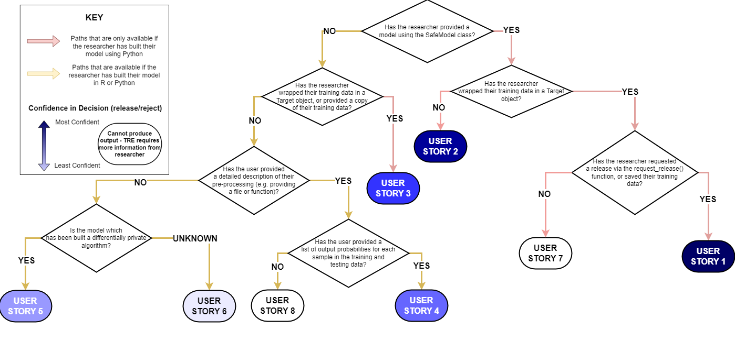
AI-SDC: User Stories

Slide 26

So it’s all sorted then ...?
We need more research and innovation so that TREs can support AI.
Statistical Disclosure Control
ML Privacy Research
Gaining a better understanding of:
Causes of vulnerability
How to describe risk?
Role of PET technologies
What is ‘sufficient preprocessing’?
Fed-SACRO?
Fed-AISDC?

